Slide 1
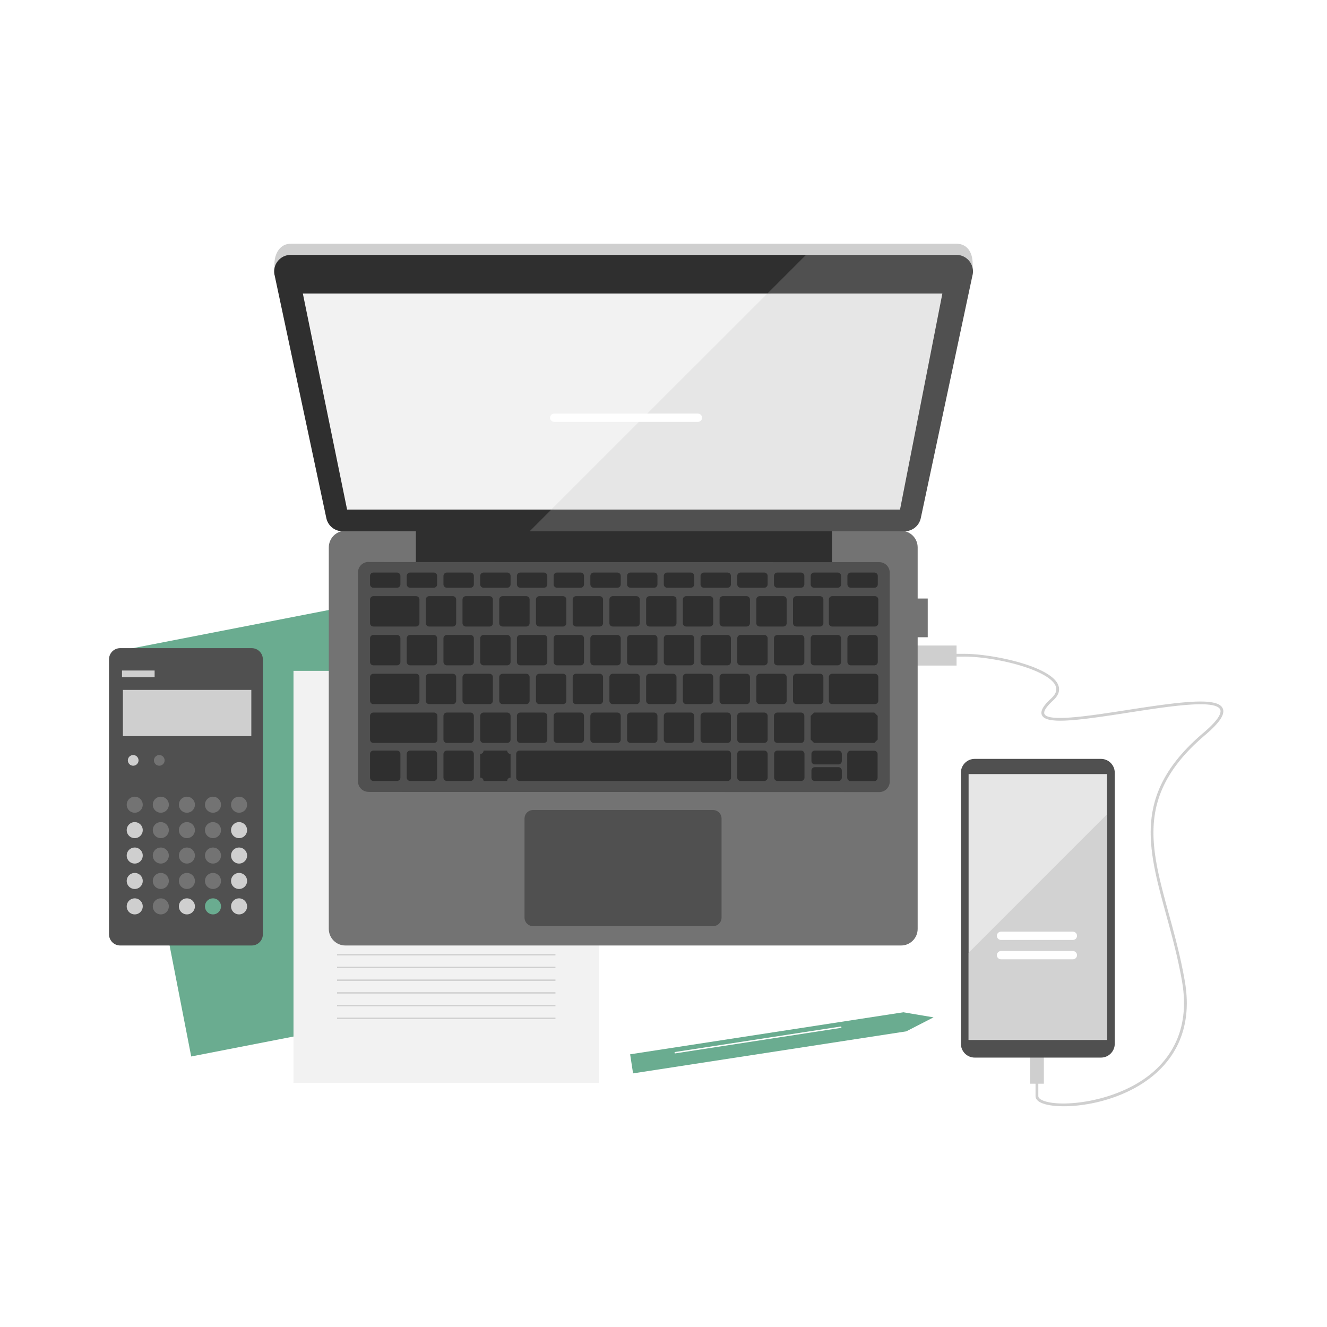
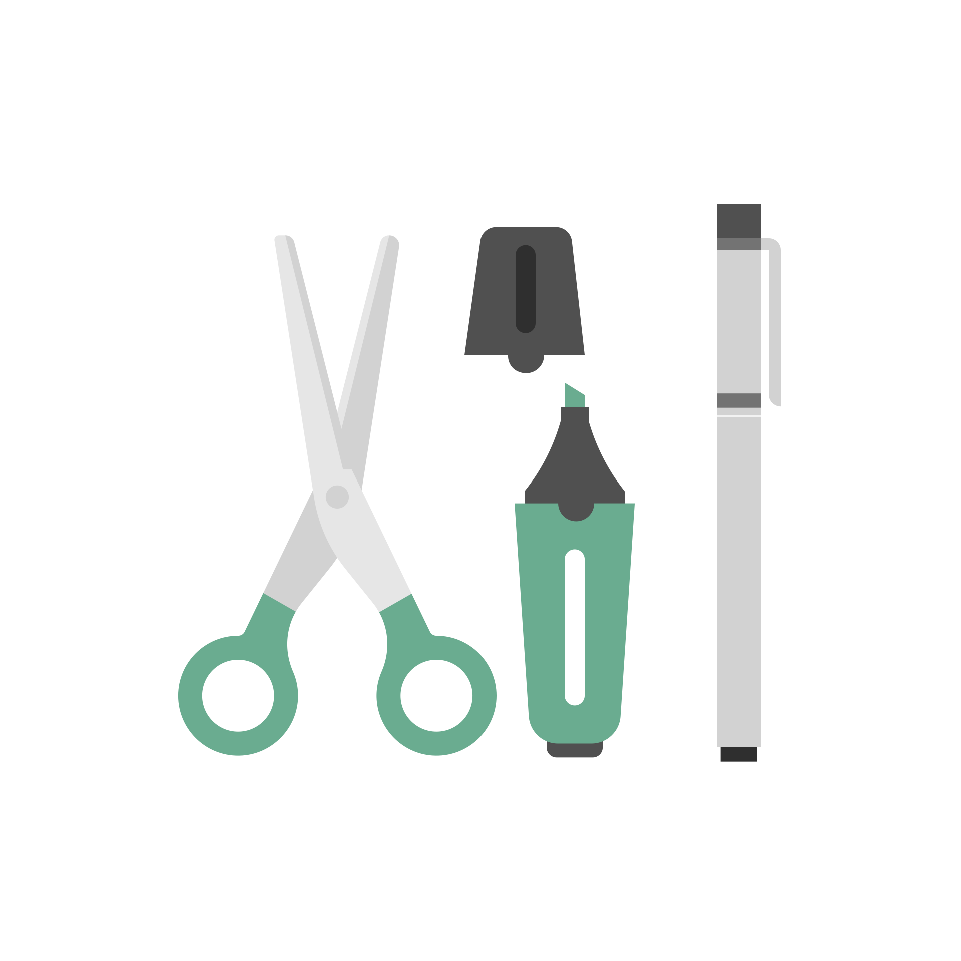
Tools and Technologies for Remote Teaching
Feel free to interrupt and ask your question during this presentation.

Slide 2
Our Class-Room Presentation
When we teach, we normally expect the students to be able to:
Hear us specking.
View the material being presented (Power point presentation or pages of the text).
See what we write on the board.

Slide 3
Zoom Class Presentation
In a Zoom class presentation with shared screen, students can
Hear us speaking.
See the material displayed on our screen
See us writing on the white board of Zoom.

Slide 4
Problem with Writing on the White Board of Zoom
We have to either type or write by moving the mouse.
Both are slower than free-hand-writing for most of us.
Writing with mouse is cumbersome.

Slide 5
Can we write free-hand?
Yes. By mirroring the screen:
“Mirroring” means displaying a copy of the screen of one device on the screen of another device. One device would be your computer in which Zoom meeting is being held and the other would be a touch-sensitive tablet device.
And by using a “Whiteboard” software on one of the devices:
A “Whiteboard Software” is one that allows you to handwrite and draw figures with a stylus pen or finger-tip on the touch sensitive device. It would also allow you to do other basic operations such as erasing part or all of the screen.

Slide 6
Mirroring for Handwriting can be done
in one of two ways
“Mirror” your computer screen to a touch-sensitive tablet and run a white board software on your computer.
Or “Mirror” a touch-sensitive tablet to your computer screen and run a white board software on the tablet. “Notes” on the tablet can work as whiteboard software.

Slide 7
What devices can be used as touch sensitive devices?
Any iPad (preferably one of newer models) and Optional Apple Pencil for writing.
Any Android tablet (best suitable one: Samsung Galaxy Tab. Phone is too small) and Stylus Pen for writing.
Writing can be done with finger-tip in most cases. However, writing with Apple Pencil or Stylus Pen makes the writing clearer, easier and faster.
Computer and the tablet should be connected either by a cable (to USB port) or wirelessly by connecting both to the same wifi network. Cable connection is recommended to avoid lag.

Slide 8
What are the Software Needed?
A “Mirroring” software.
A ”White Board” software
As indicated earlier, mirroring software makes a copy of the screen of one device display on the screen of another device. White board software allows you to handwrite on the touch-sensitive device and offers tools for erasing etc.
I will explain or demonstrate some of the combinations of devices and software next.

Slide 9
Apple Computer and iPad Combination
Download “Astropad” mirroring software on both devices. The one for Mac can be found by google searching. The one for iPad is called “Astropad Standard” and it is in the App Store. They are both free.
If you run the software on both devices and if the devices are connected, a portion of the computer screen gets mirrored on the iPad. The portion that is mirrored can be relocated and resized.

Slide 10
Apple Computer and iPad Combination
Run any “white board” software on the Mac. Recommended one is an online white board called “AWW app Online Whiteboard”. You can find this by google searching “AWW App”. No downloading. The website itself is your white board. Open it on a new window and move it to the portion of the screen that is mirrored.
Now anything you write on the iPad shows on the mirrored portion of the computer screen as well.
You can have power point presentation or other material displayed on the remaining portion of the screen.
I am going to demonstrate this set up now. The picture in the following page shows the hardware setup.

Slide 11
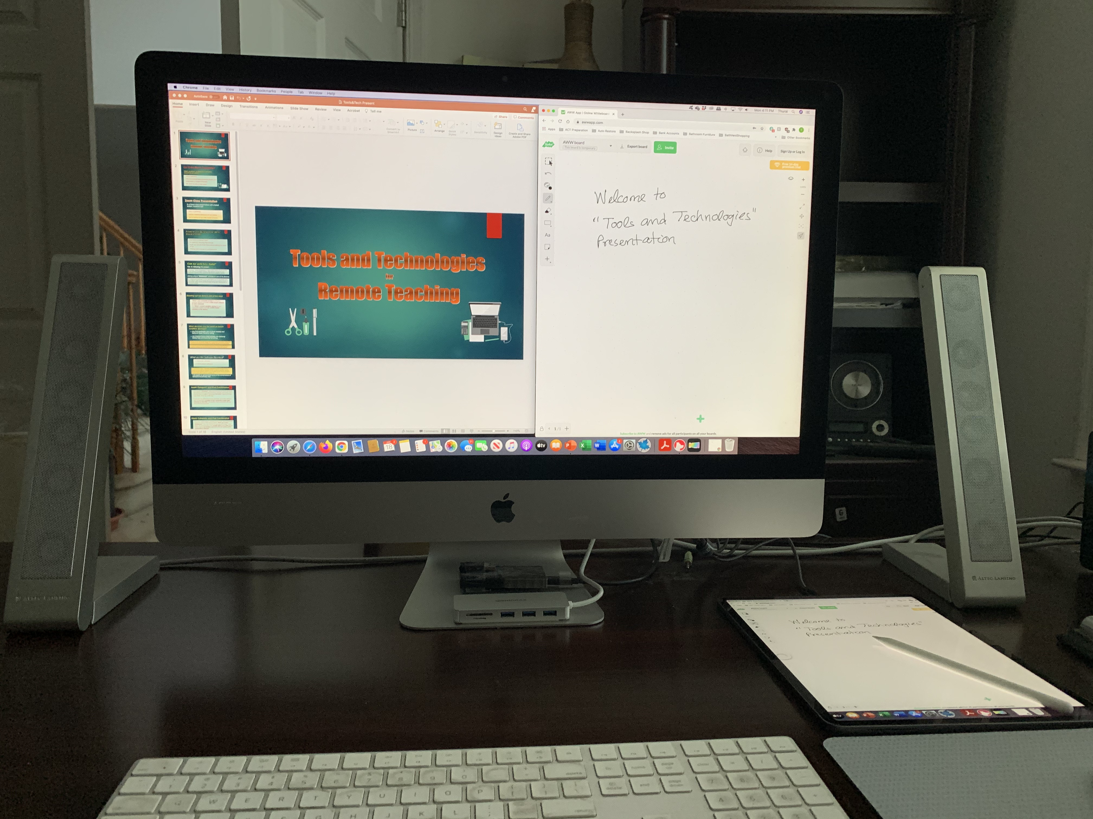
Hardware Setup with iMac and iPad
Right half of the computer screen is mirrored on to the iPad laying down on the desk. What you write on the iPad with Apple Pencil or finger-tip shows on both devices.

Slide 12
Note
One advantage with this set up is that you can display your writing on half of the screen while displaying some other material on the other half.
Another advantage is that you are writing on the device that is laid flat on your desk with Apple Pencil or finger tip.
This system works beautifully.
Astropad is currently not available for Windows. It is in the making. Even if it is available, iPad combined with this software is not going to work with Windows as nicely as it does with Mac because of the difference in the screen sensitivity technology.

Slide 13
Can we use Samsung Tablet?
One might wonder: In the above set up, can we use a Samsung tablet in place of iPad? Answer is yes. There is “LetsView” mirroring software to mirror the iMac (or Windows) screen to Samsung device. But the set up doesn’t work all that well.
I will be demonstrating how to use “LetsView” on Windows computer later.
So, I will not demonstrate the details here.
LetsView allows you to mirror computer screen to any tablet device and vice versa.
The pictures in the next two pages will show you how the displays appear.

Slide 14
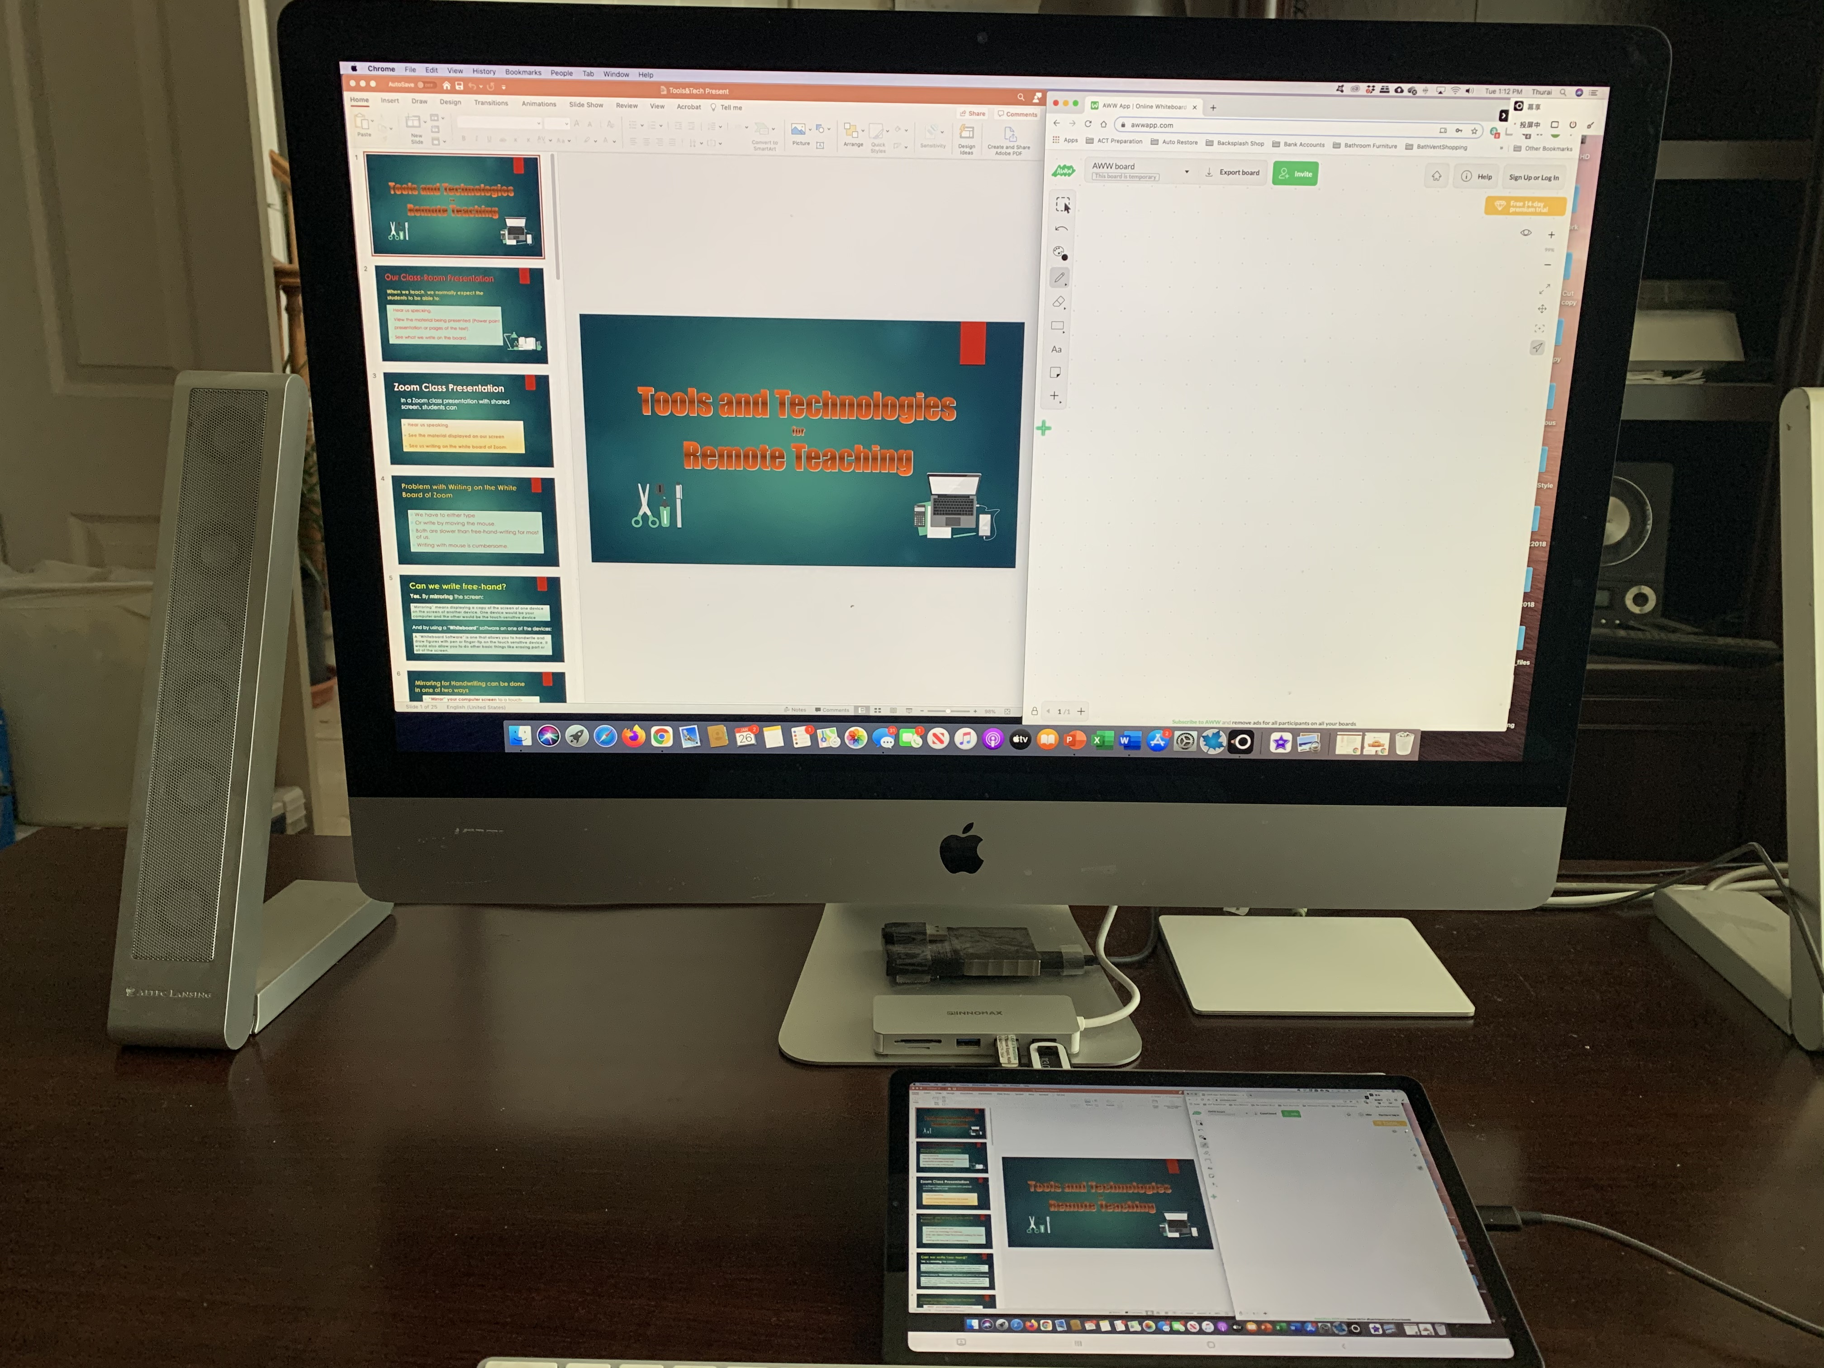
Mac with AWW App Whiteboard and Samsung with LetsView Mirroring the Computer Screen to Samsung
As the picture shows, the entire screen is mirrored to the tablet. Not a portion.
Can’t write on the tablet at all.

Slide 15
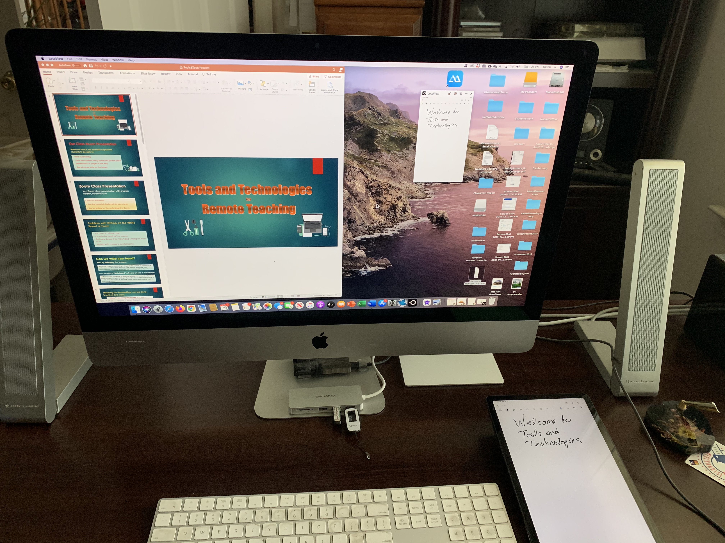
Samsung Tablet with “Notes” as Whiteboard with LetsView Mirroring the Tablet Screen to Mac
This set up works. But the image of the tablet on Mac screen is too small and cannot be resized.

Slide 16
Working with Windows Computer
The best of the set ups shown above (Mac with AWW whiteboard and iPad) cannot be made to work with a Windows computer using any Mirroring software due to differences in the technology. Computer screen can be mirrored to iPad or to Samsung Tablet. But what you write on the device will not show on the computer screen.
But there are other ways. The other ways useful with Windows computer will be discussed next

Slide 17
Writing on a Touch Sensitive Windows Computer Screen
You can use a browser to visit the “AWW App White Board” on your touch sensitive Windows computer. Move it to cover part of the screen.
Write or draw directly on this white board by using any stylus pen.
You can have other things displayed on the rest of the screen.
The inconvenience with this set up is that reaching the computer screen and writing on it can put strain in your hand.
The picture on the next page shows this set up.

Slide 18
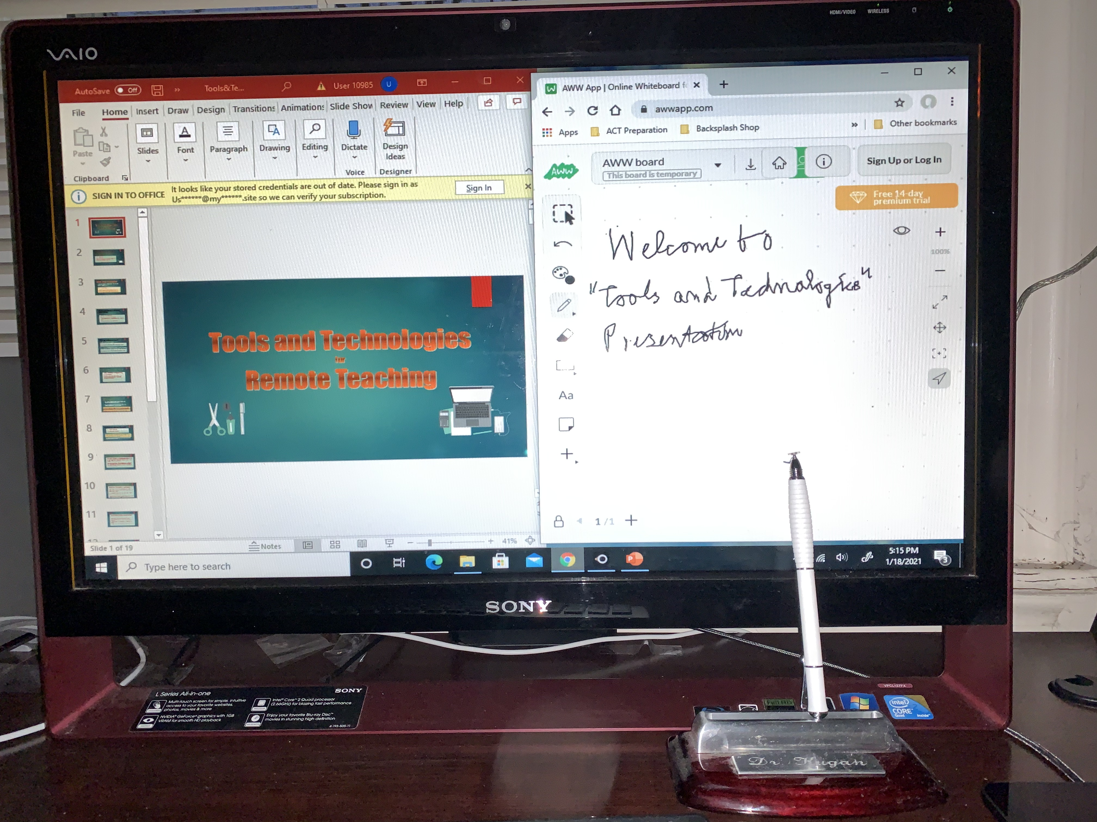
Writing Directly on Touch Sensitive Windows Screen
Advantage: Any stylus pen or even finger-tip can be used to write.
Disadvantage: Strain on the hand.

Slide 19
Mirror a Touch Sensitive Tablet to Windows
Computer
Mirroring a touch sensitive device to Windows computer is the only way you can write on the device that is laid flat on your desk and make it show on a portion of the Windows computer screen.
The method described next works with both iPad and Samsung devices in the exact same way.

Slide 20
iPad or Samsung Tablet Mirrored to Windows Computer
Mirroring an iPad or Samsung Tablet to Windows computer screen (or vice versa) can be done using variety of mirroring software available in the market. The “LetsView” software described on the next page is one of the free ones.
As noted earlier, mirroring Windows computer screen to a touch sensitive device is not useful. What you write on the device will not show on the computer screen.
So, we shall mirror the screen of the touch sensitive tablet to the computer screen.

Slide 21
Mirroring iPad or Samsung Tablet to Windows Computer
Have the computer and the device connected by a cable (or to the same wifi).
There are many screen mirroring software available for this set up. “LetsView” is one of the best among the free ones.
Download “LetsView” on both devices and go through the installation process. The one for the iPad and Samsung device would be found in the Appstore and PlayStore respectively.
Execute LetsView on both. It will show you two options at the top of the screen on the computer:
1. Phone Screen Mirroring
2. Computer Screen Mirroring

Slide 22
Mirror Your Tablet-Screen
“Computer Screen Mirroring” option allows you to mirror the computer screen to the screen of the device. This is not useful as noted earlier.
“Phone Screen Mirroring” option allows mirroring the screen of the tablet to the computer screen. Select “Phone Screen Mirroring” on the computer.
On the device you should see a list of devices detected to be running “LetsView”. One of them should be your computer. If you don’t see any, click at “Redetect”.
Click at the computer-name that is detected. Then select “Phone Screen Mirroring”.
If you are using a Samsung Tablet, as soon as you click at the computer-name that is connected and then select “Phone Screen Mirroring” the connection is established. A permission window pops up. Click at “Start Now”.

Slide 23
Mirror Your Tablet-Screen (ctd)
If you are using iPad, then it will ask you to go to “Access Control Center” and tap “Screen Mirroring” and choose your computer-name. Follow the instructions.
A permission-window may appear on the computer. Click “allow”.

Slide 24
The Device has been Mirrored
Your device-screen now appears on a portion of the computer screen.
You can run any Whiteboard software on the tablet now. If you don’t have any other better ones, run “Notes”. It is one of the best.
Click at the “Pencil” tool, select the type of pencil you want to use, and write with Apple Pencil on iPad or stylus pen on Samsung device.
You can display other materials on the remainder of the screen that can be seen by the students.
Pictures on the next page show the set up.

Slide 25
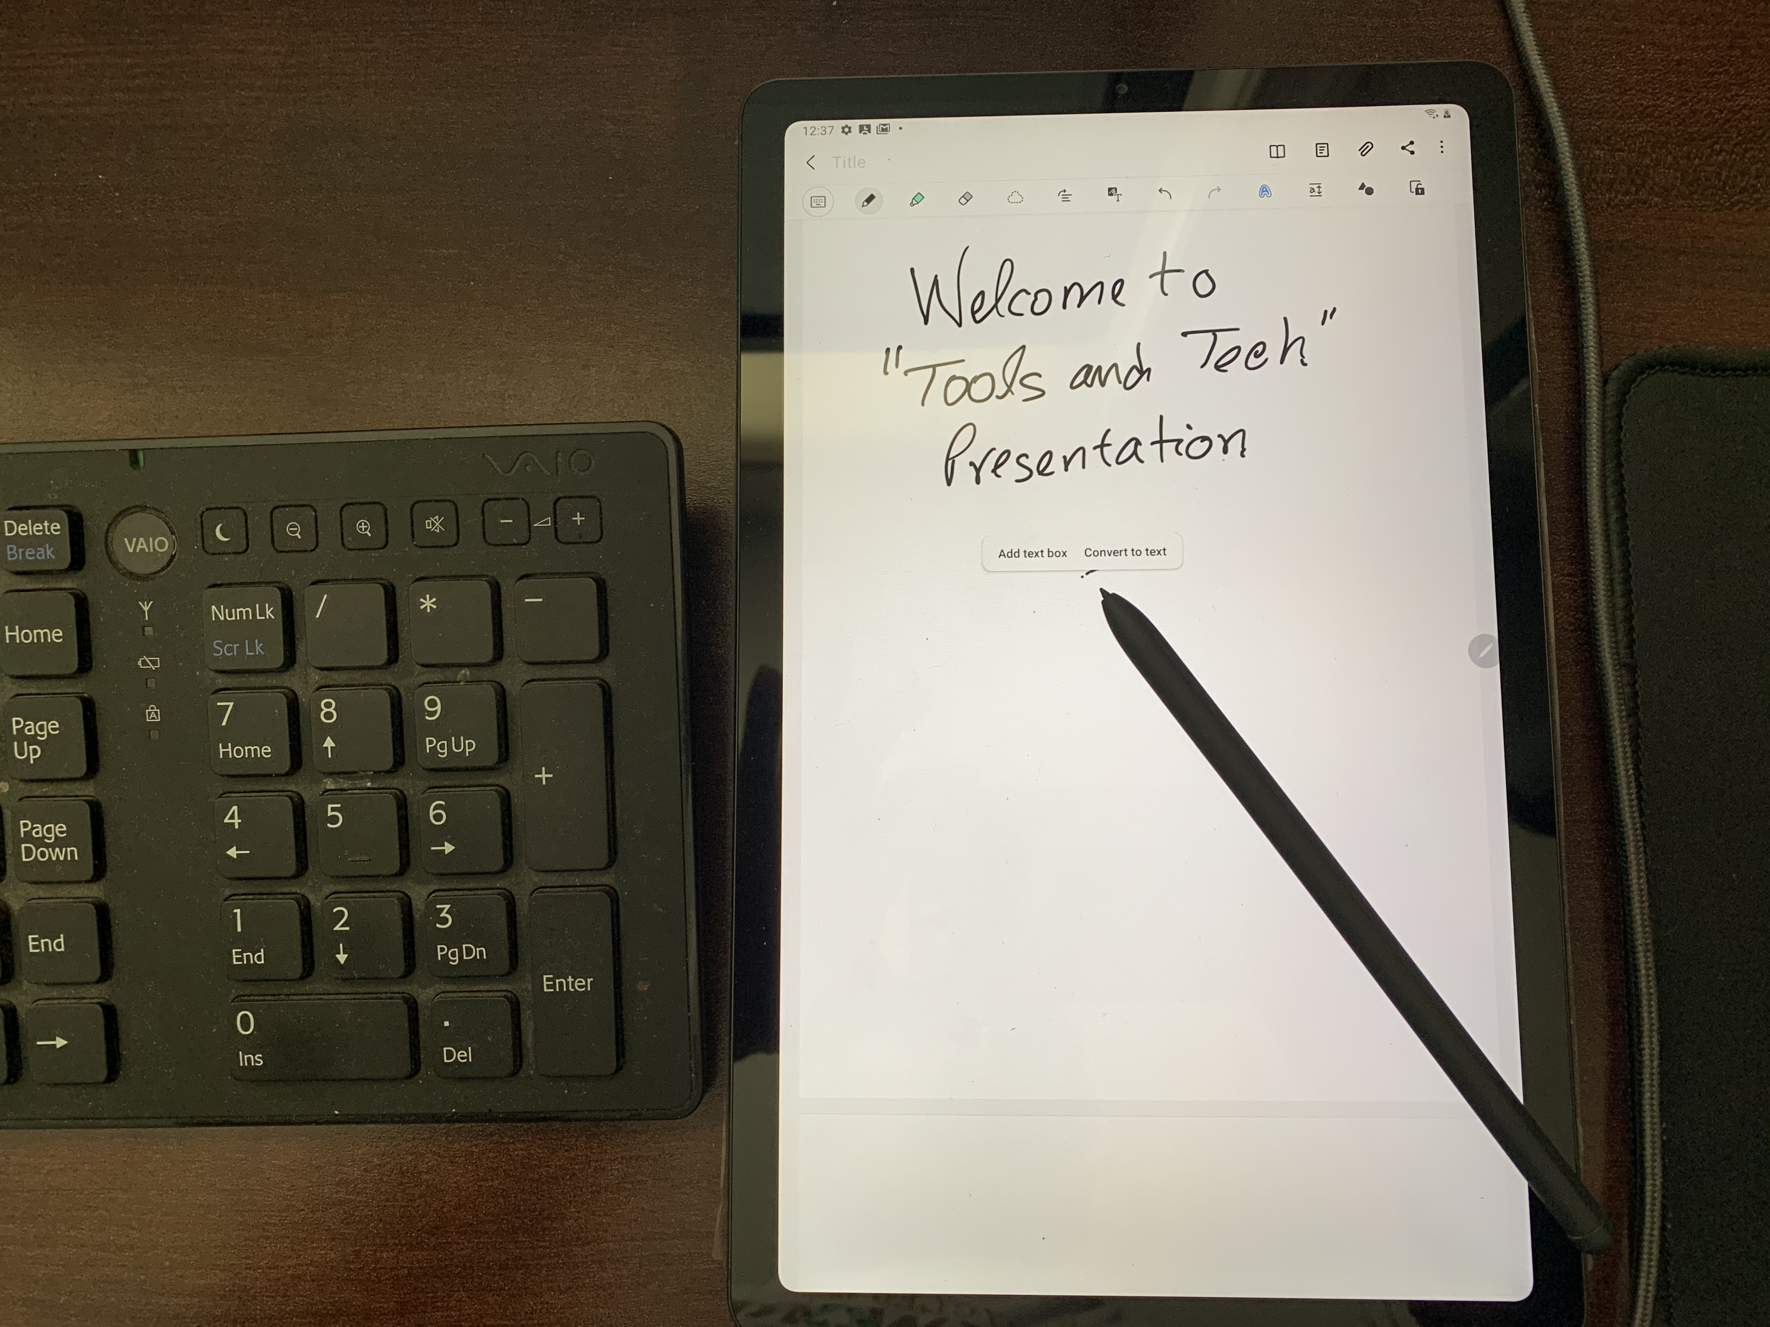
Samsung Note 6 Mirrored to Windows Computer
Screen of Samsung Note 6 is mirrored to a portion of the computer screen. “Notes” software is running on Samsung tablet. It allows you to handwrite, draw, erase etc.

Slide 26
iPad device Mirrored to Windows Computer
Screen of iPad is mirrored to a portion of the computer screen. “Notes” software is running on iPad. It allows you to handwrite, draw, erase etc.

Slide 27
Comparisons
The iMac and iPad combination allows you to reshape and resize the portion of the screen used for writing. The other setup doesn’t.
In the Windows set up, the size of the display of the tablet-screen on the computer screen is smaller than we would like. But it cannot be re-sized.
In the Windows set up, the display of your writing on the device transmitted to the computer screen is not very sharp, particularly with iPad.
For the Windows set up Samsung tablet screen mirroring works better than iPad screen mirroring.
I didn’t try any screen mirroring software that costs money (for example, “Super Display”). There may be one that works for Windows better than LetsView. Research it yourself.

Slide 28
Thank you for joining this presentation.
Feel free to email me if you want a copy of this power point presentation or if you need my help in setting up your computer system for remote teaching.
My email address is: tkugan@jjay.cuny.edu.
If you like to get a copy or link to the video of this presentation, send an email request the organizers of FDD.

