Slide 1
Closing the Loop: Using Outcomes Assessment Data to Impact Classroom Pedagogy and Curriculum
Tim McCormack and Christen Madrazo
John Jay College Vertical Writing Program
Faculty Development Day
January 2021

Slide 2
“MIDDLE STATES IS COMING GET YOUR DUCKS IN A ROW!”

Slide 3
Get out the pitchfork…
Collect the OA data and write the report.

Slide 4
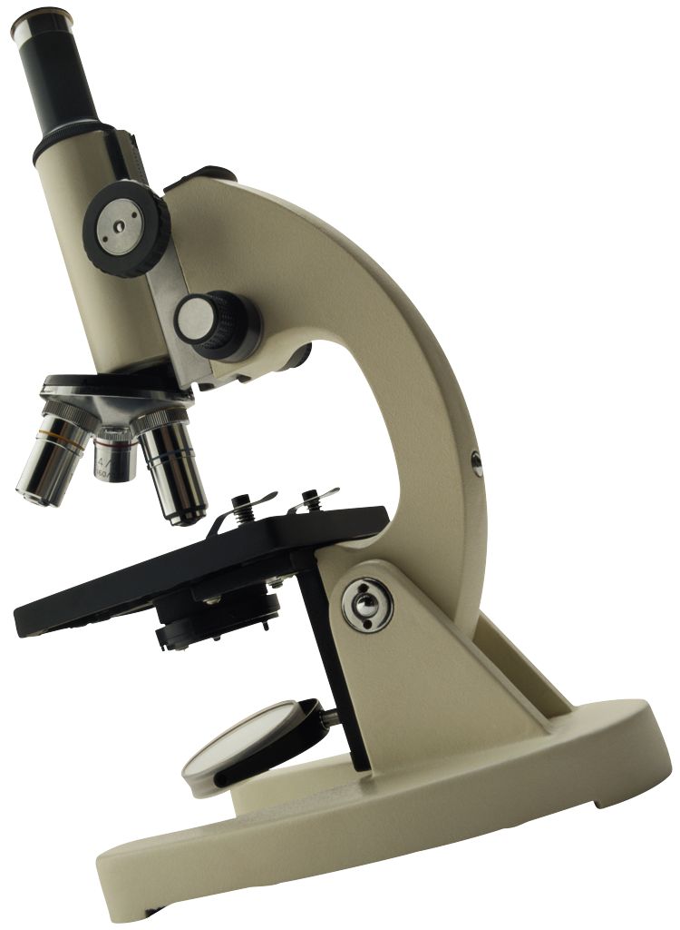
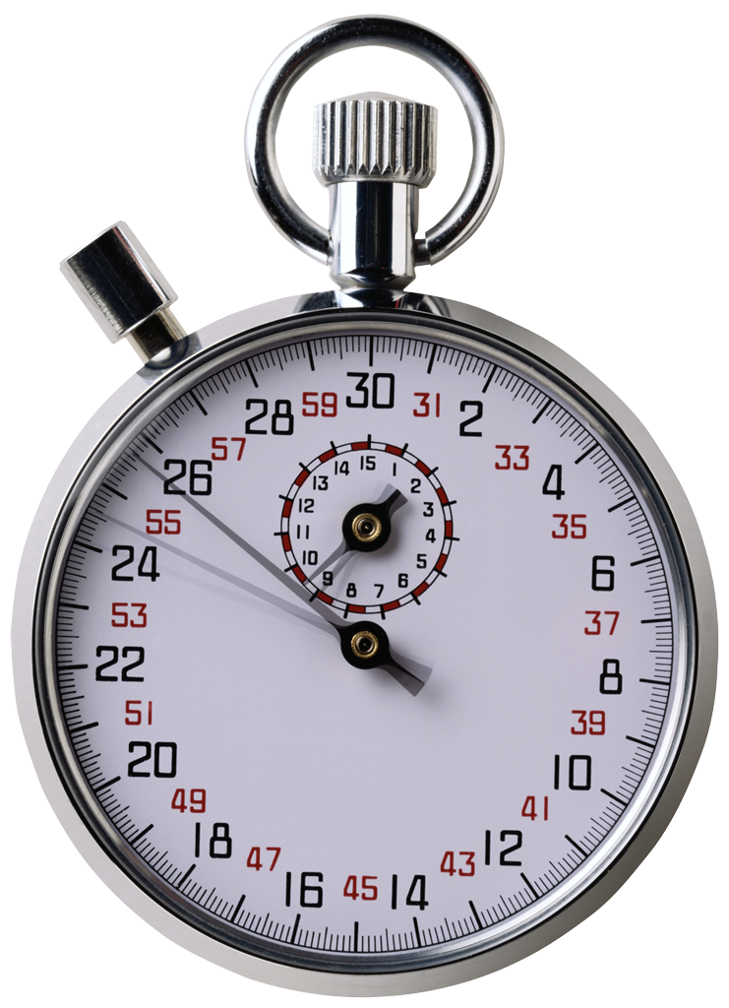
Typical OA Process: Streamlined, logical, linear, scientific, terminal.
OA Objectives
Data Collection
Report:
Findings
What’s missing?

Slide 5
2009-2010: Starting the Process
National Standards/Peer Institution
Research
SOTL Assessment Research
Classroom Faculty Discussion

Slide 6
2010-2011 Formative Assessment
Faculty Developed Learning Objectives
Design Assessment Pilot
Analyze/Share Data
Improve/Extend Assessment
Faculty Development

Slide 7
2011-2015
Faculty Discussion
Assessment Design/ Results
Faculty Develop-ment
Faculty Mentoring
Classroom Practice
Curriculum/Pedagogy/Program Changes

Slide 8
Direct/Indirect Assessment
Portfolio Review
Faculty Focus Group
Syllabus Review
Triangulated Data

Slide 9
Focused Participatory Assessment
Faculty Participation (Part Time and Full Time)
Modified Each Year
Additive/Not Holistic

Slide 10
OA as Educational Justice
Students should not be playing a game of chance.
OA leads to a consistent and coherent curriculum that provides each student with an equal opportunity for growth and success.

