Slide 1
Quantitative Literacy in the Classroom, No Matter What You Teach (Part 2)
Andrew Sidman
Interim Dean of Academic Programs
Professor of Political Science
QR Enthusiast

Slide 2
Limits of curriculum (00-05)
What is QR
QR lessons and assignments
Anatomy of a QR lesson (10-25)
QR learning outcomes
Math skill refresher
The skill in context
Examples (lots of them)
Anatomy of a QR assignment (25-35)
Clear instructions
Tasks to assess each step in using the skill
DRAWING A CONCLUSION
Adding in tools (35-45)
Workshopping lessons & assignments (45-55)
Resources (55-end)

Slide 3
QR in Our Curriculum
Expectation that students will write is ubiquitous
Writing instruction, less so
We write, so they must write
Writing Across the Curriculum
QR – not so much, except for STEM fields
“I’m not good with numbers”
QR as a crucial, academic skill is different from quantitative analyses as a mode of research.

Slide 4
QR in General Education
9 credits (3 out of 40 courses)
Required Core: Math & Quantitative Reasoning
Required Core: Life & Physical Sciences
Flexible Core: Scientific World
Anywhere else? Not really-- not systematically.
2016-2017 assessment: 87.6% of the same of student work from Flex Core and Justice Core courses showed no evidence of QR
“It seems likely, then, that quantitative reasoning in most General Education courses is incidental, not formally integrated into student learning, and neither taught, required, nor suggested on most assignments.”

Slide 5
QR in Undergraduate Programs
Outside of STEM fields
8 majors require STA 250, or else have a research methods course with an explicit quantitative component
3 majors have an experience like this as elective
14 majors do not have a QR course as a requirement or an option
This matters because is contributes to the inconsistency of developing this skill

Slide 6
Limits of Curriculum
We can only create so many courses.
We can’t play with Gen Ed too much.
Skills without content and context are not very useful.
Like expectations for writing, we should expect students to engage in QR in every course.
But this means we have to ask students to engage in QR in every course.

Slide 7
QR as a Pedagogical Tool
QR is an important skill for understanding, comprehension, critical thinking, and decision-making.
Integrating QR into the content we teach enhances a student’s ability to understand the content.
Integration means making the QR expectations EXPLICIT through
Classroom instruction
Readings and activities outside of class
Assessment of students’ work

Slide 8
I Don’t Do Regressions
A fair amount of the resistance to integrating QR into our classes is this:
I don’t do/understand/believe/like statistical analyses.
Or more simply, I’m not good with numbers.
That’s not QR – or at least it’s only a part of what QR is and how QR should be introduced and taught to our students.

Slide 9
QR Defined
We can broadly think of quantitative literacy as the ability to read and understand numerical information.
Quantitative reasoning is the ability to produce, manipulate, and make decisions using numerical information.

Slide 10
Implicit QR Expectations
Tables and figures in course readings
Numeric information in the text – amounts, comparisons, percentages, etc.
How often do we assume that students can understand this information?
How often do we ask students to use this information in assignments and exams?

Slide 11
QR in the Classroom: Basics
Bringing QR into the classroom means changing the implicit to explicit.
One basic technique for doing this is to:
Emphasize the quantitative information that is already part of the course content
Ask students to use this information to demonstrate understanding of the content
Example from Michael Holt’s The Rise and Fall of the American Whig Party
Election returns used to demonstrate the incoherence of Whig partisanship in 1830s Mississippi

Slide 12
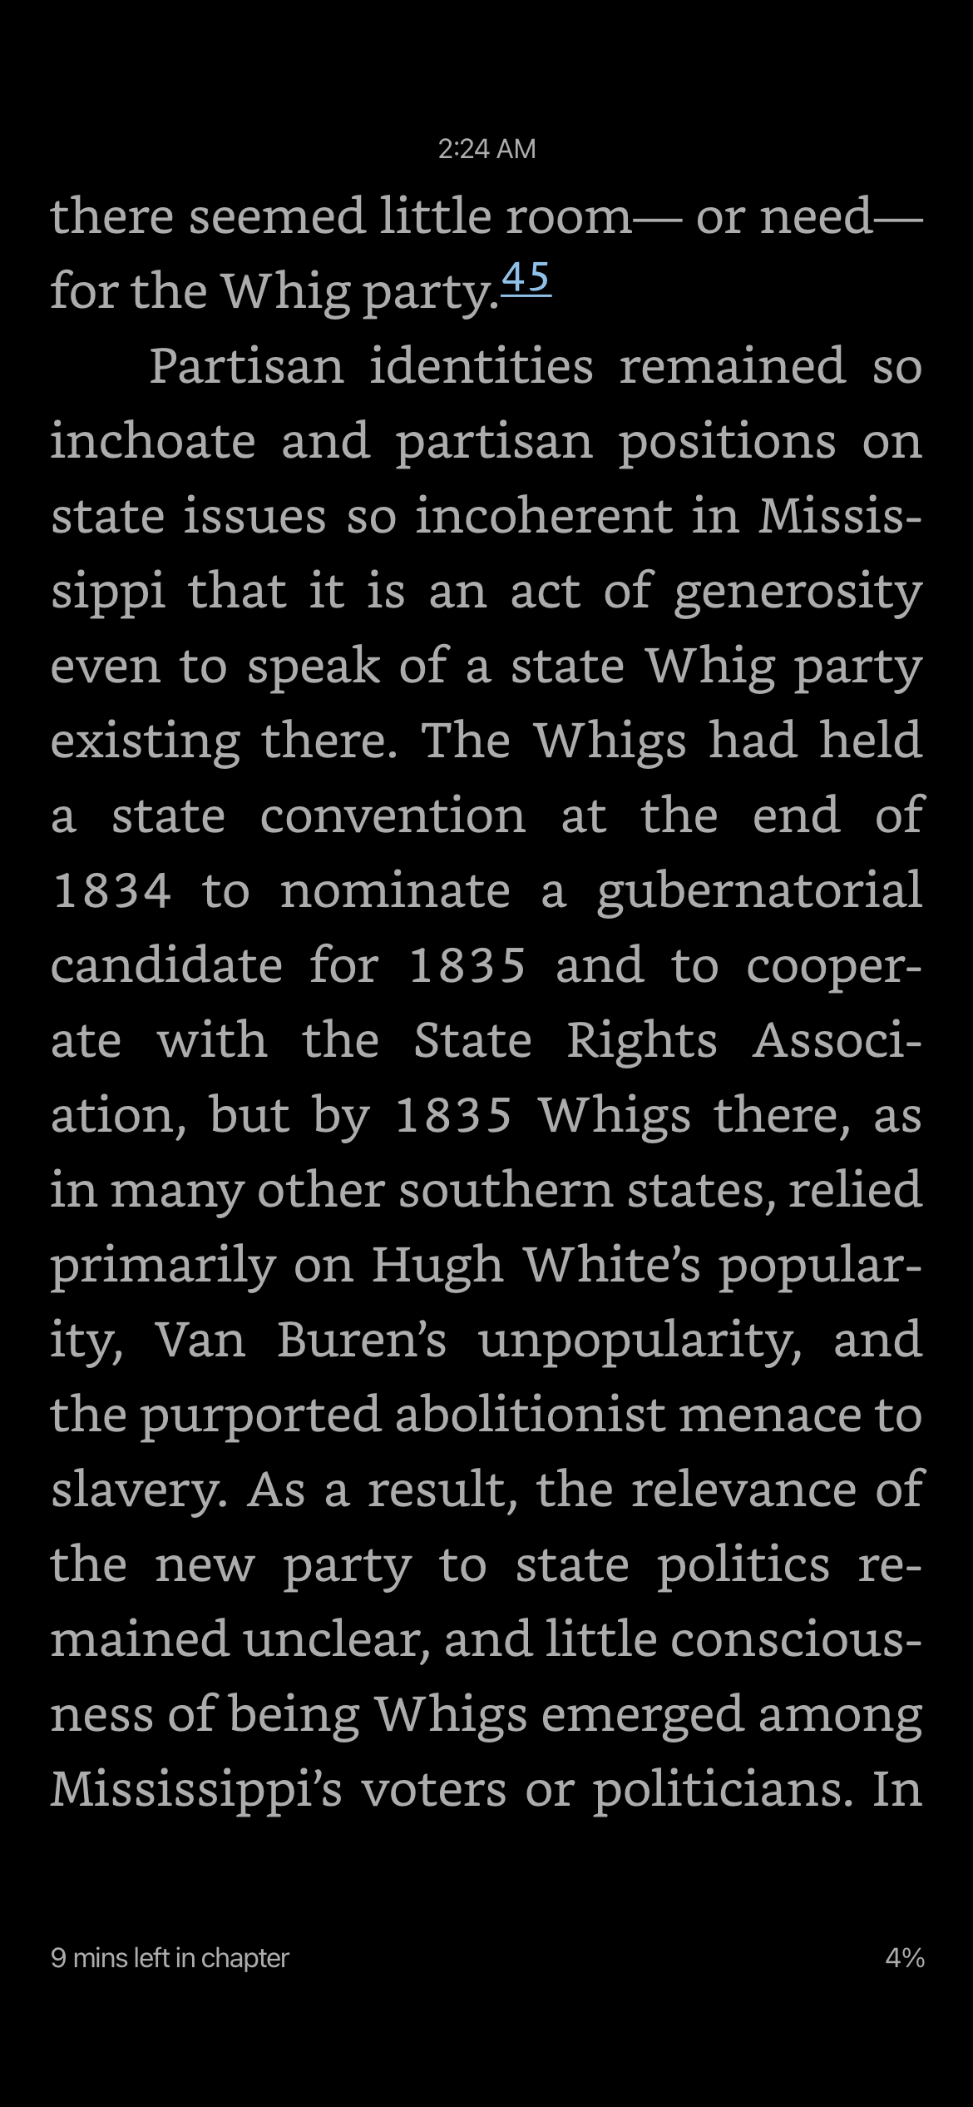
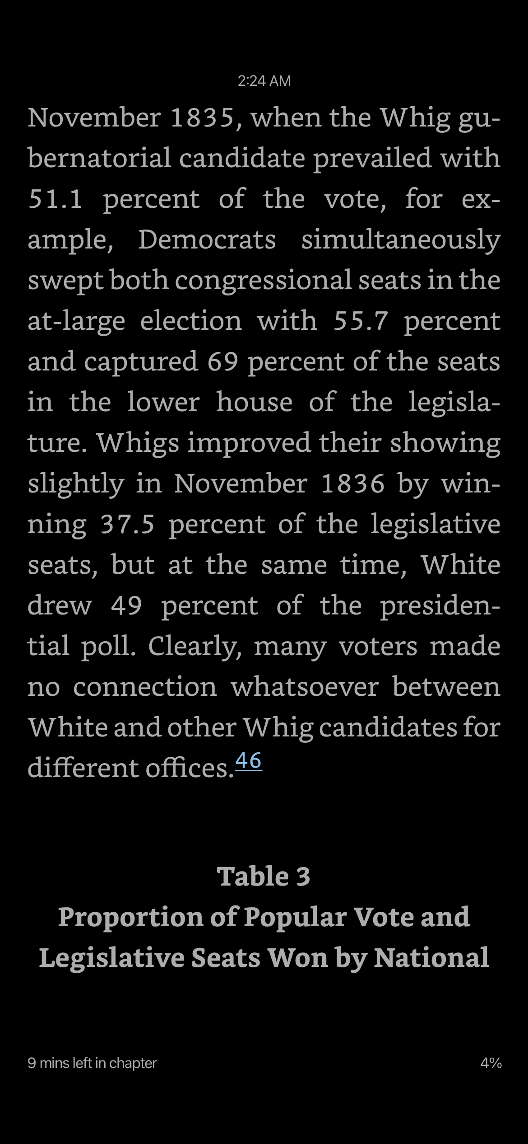
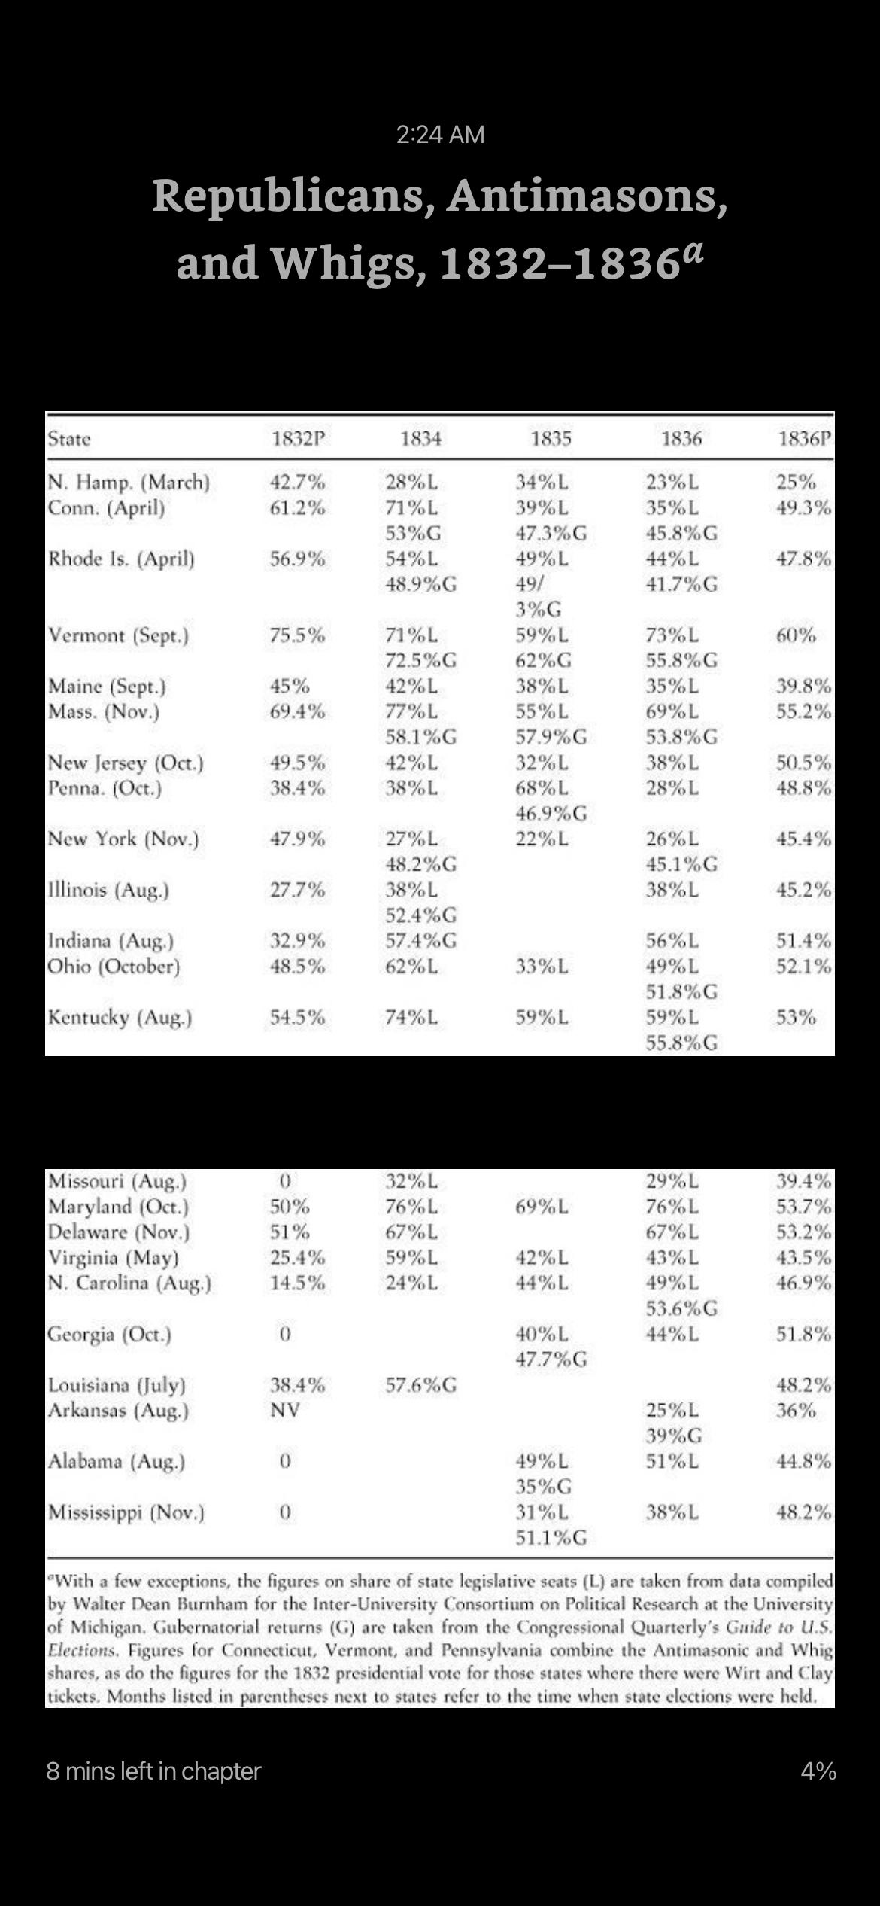

Slide 13
Best Practices
Explicitly introduce a QR skill embedded in the content of the course
Develop a QR Lesson
Identify the learning outcomes
If needed or desired, teach the underlying math skills
Demonstrate the QR skill in context
Provide lots of examples
Let students practice this skill in an assignment
Assess how well the lesson and assignment worked

Slide 14
QR Lesson
Develop learning outcomes
Knowledge and conceptual understanding: the the things students need to know to properly develop the skill
Thinking and other skills: how students will use the information provided
Attitudes, values, dispositions and habits of mind: how students will develop the habit of using the skill in similar contexts
Present the mathematical skills students need to perform the task
Teach the content using the skill and provide examples

Slide 15
Lesson Example
Veto Bargaining

Slide 16
QR Assignment
If the lesson introduces the skill, then the assignment should be similarly introductory.
The assignment should be the place where students practice the skill.
The stakes should be relatively low and the tasks should guide the student through full demonstration of the skill.
In the example, students are asked to identify the information they need first, then use the right method to draw a conclusion.

Slide 17
QR Assignment
Veto Bargaining

Slide 18
Assessment
Did the lesson and assignment work?
Can students use the skill to draw proper conclusions without the guidance?

Slide 19
Brainstorming
Is this something you already do?
If so, how?
If not, what is a topic you teach in one of your courses that can be developed into a QR lesson?

Slide 20
Resources
Library guides: https://guides.lib.jjay.cuny.edu/
Links to lots of sources of data on a wide range of subjects
Roper Center for Public Opinion Research: https://ropercenter.cornell.edu/
We have an institutional subscription
It is one of the most comprehensive repositories of public opinion data
Math Science Resource Center: https://www.jjay.cuny.edu/math-and-science-resource-center
Provides tutoring services for students
Numeracy Infusion Course for Higher Education (NICHE): https://serc.carleton.edu/NICHE/about.html
Tons of information on QR in the classroom

Slide 21
THANKS FOR JOINING US!
Fall 2023
Faculty Development
Day
THANK YOU FOR PARTICIPATING!!!
Have a great start to the term!
Throughout the day:
Post your screenshots, quotes, and insights to share on Twitter and Instagram:
@JohnJayTLC #JJC-FDD
Make notes of who you met and what you learned: keep track of what inspires you!
Complete the FDD Feedback survey: we will email you a link
Keep an eye on your faculty email for TLC announcements:)

