Slide 1
Accessibility as Equity and Wellness
Transition to Brightspace
Evan Silberman, LMS Transition Lead
Nathalie Zarisfi, Interim Director of Change Management

Slide 2
Defining Accessibility: 1 Word Answers
5 Minute Reflection – What does accessibility mean to our students? What is access, broadly in the learning journey, re: technology?
As a small group, compose one or more responses (one to two words). Text NATHALIEZARISFI130 to 37607 to join the session, then text your response. You can text as many times as you like.

Slide 3
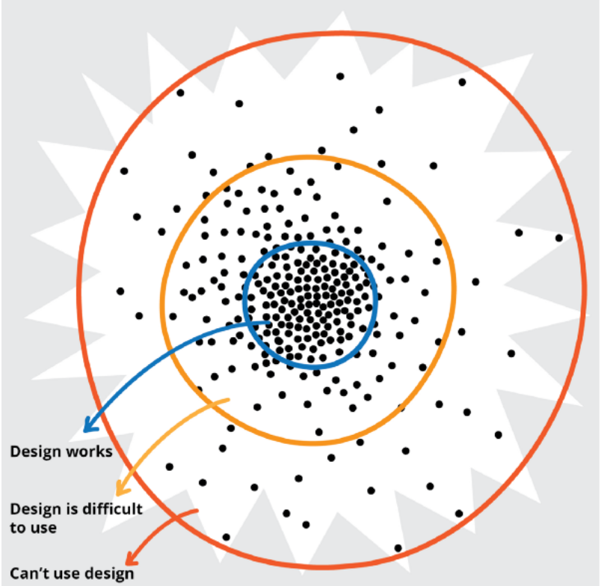
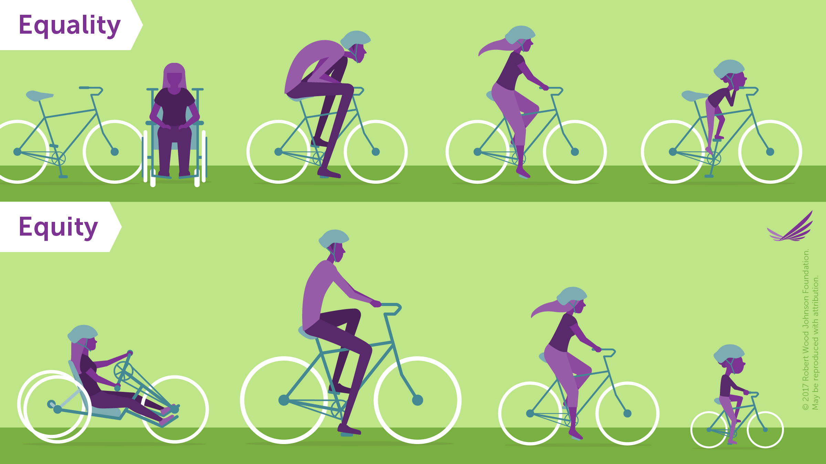
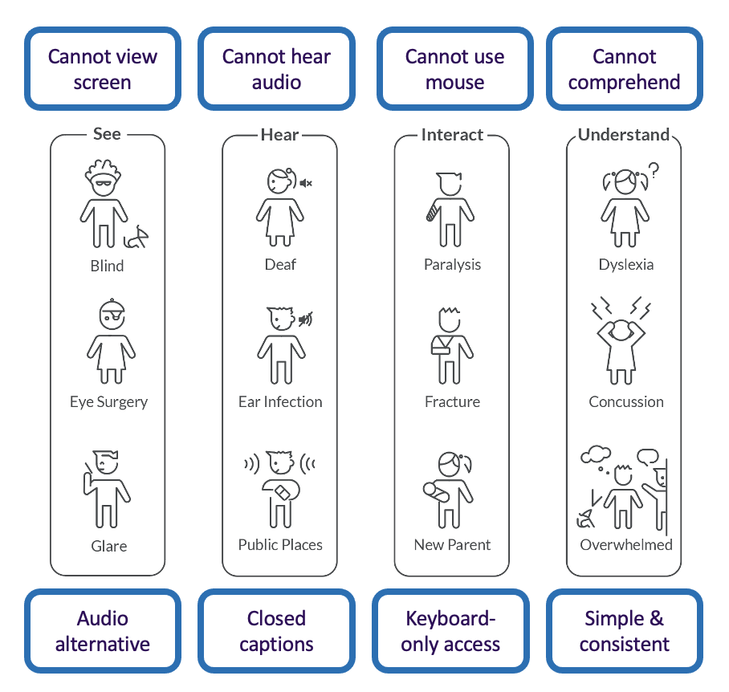
Inclusive Design
IDEA
Design for Inclusion
Recognize Diversity
Our Partner
Fable
Strategic & Exploratory Research
Enable Equity
Enhance
Access
Design Exploration
Define & Test
WCAG (2.1) AAA

Slide 4
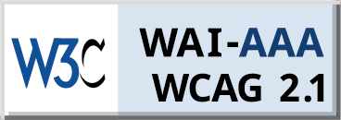
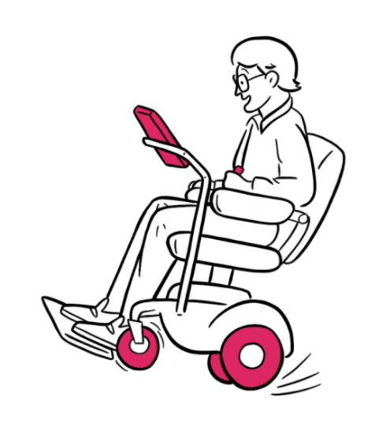
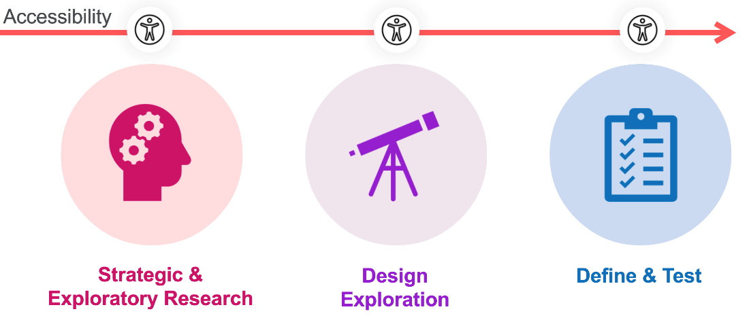
Compatible Technology
Technology
Conformant with global accessibility standards
Designed WITH
people with disabilities
Accessibility integrated into Research, Design & Development
EN 301 549
Fable Partnership
Notes:
Technology accessibility
Our product process is embedded with accessibility criteria from WCAG 2.1 AAA standards.
We align with the functional accessibility criteria specified in the European EN301549 standards.
We engage with people with disabilities during our product process both inhouse and via our partner Fable.
We have accessibility embedded into our research, design, development, testing and support triage.

Slide 5
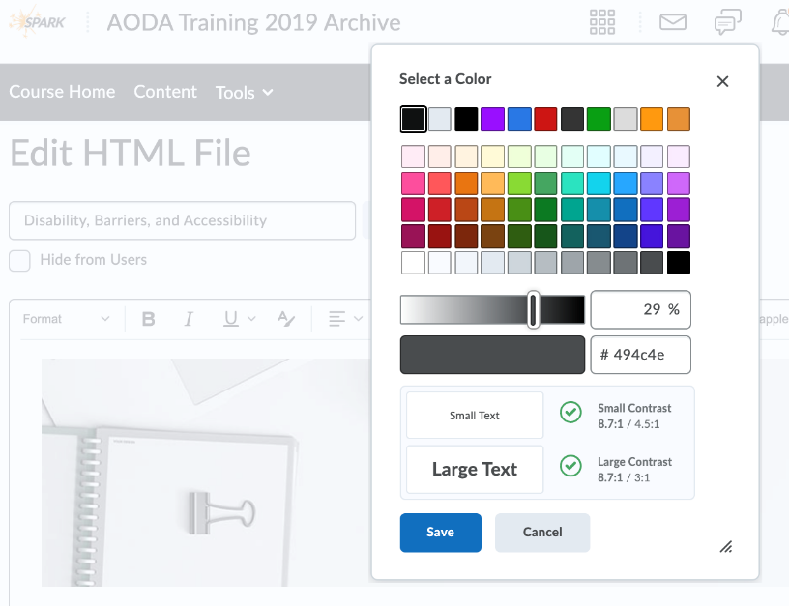
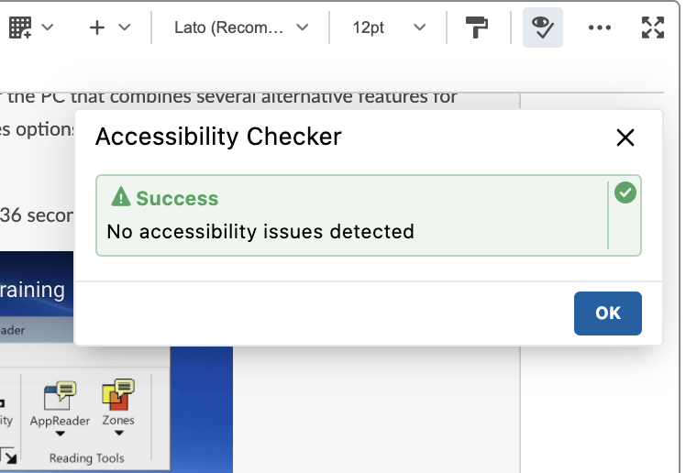
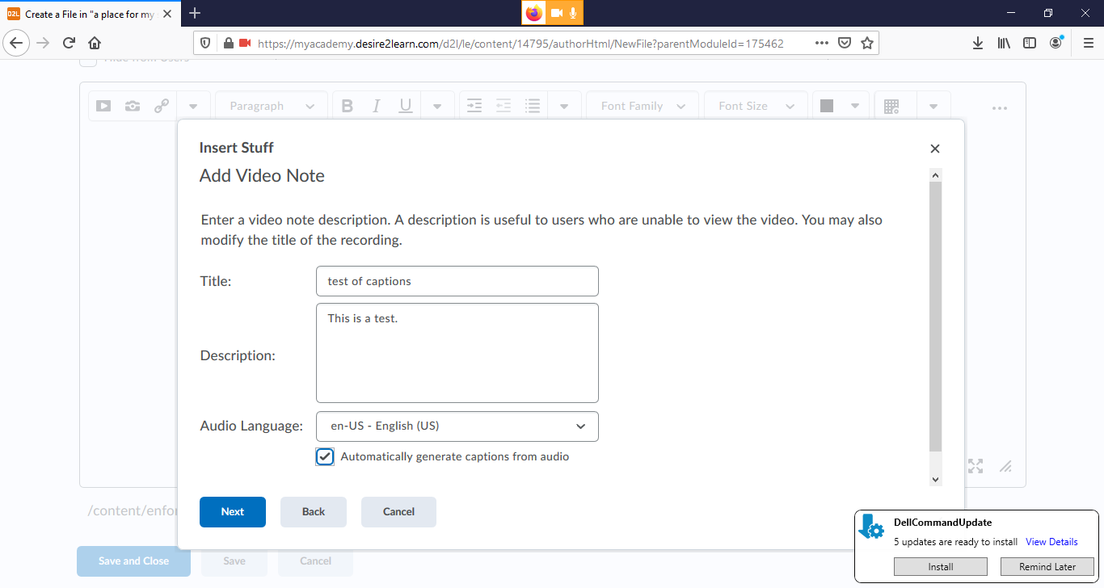
Accessible Content
Content
Accessible authoring tools
Built-in accessibility checker
Insert Video/audio Notes
Upload Video/Audio lessons
Accessible video creation/captioning
Accessible HTML templates (download)
Headings – Editor option
Color selector – Editor option
Image alt text – Editor option
Insert stuff – url – Editor option
Tables – Editor option
Math Equation editor
BB Ally Content Accessibility Service
Notes:
Content accessibility
We offer accessible HTML course templated that can be customized to your brand.
Our HTML editor provides cues to follow accessible design practices.
Our Video Note tool helps you record personalized video content and messages with editable auto captioning.
Any video uploaded to Brightspace Content area can be auto captioned since January release.
We offer partner tools such as SensusAccess for alternative formats and BB Ally for accessibility audit.

Slide 6
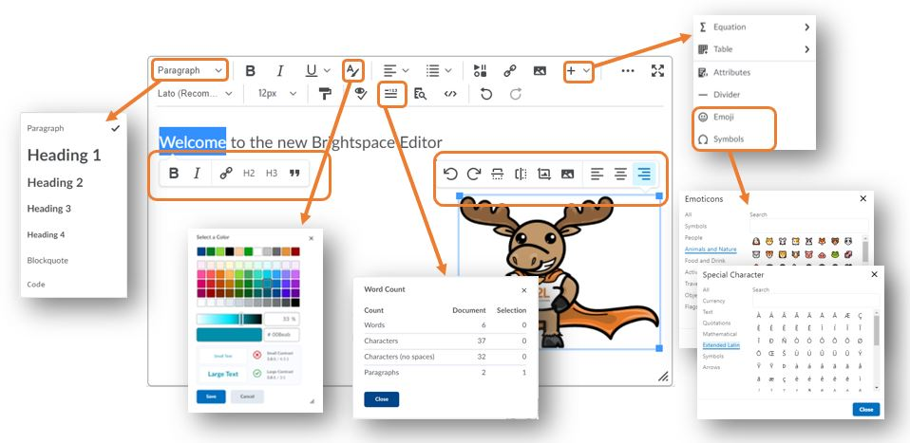
Brightspace Editor
About the Editor

Slide 7
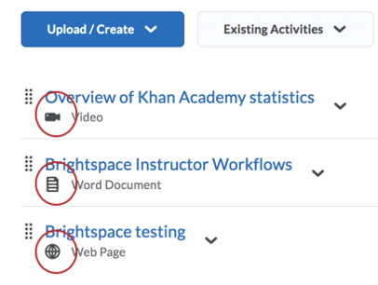
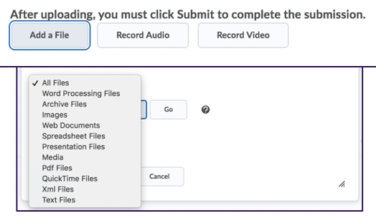
Inclusive Pedagogy
Pedagogy
Aligned with Universal Design for Learning principles
Provide content in multiple formats
Watch D2L’s Public Webinar on UDL
Enable submissions in multiple formats
Multiple means of representation
Build in mechanisms for engagement and motivation
Multiple means of action & expression
Multiple means of engagement
Notes:
We support Universal Design for Learning (UDL) in the pedagogical practices of educators.
Our features enable educators in multiple means of representation of learning content, empowers students in adopting multiple means of action and expression for assessment and multiple means for engagement for educators and students.

Slide 8
Supports for Learners with Disabilities
Brightspace is fully usable without mouse with only a keyboard (Support for Physical Constraints)
Brightspace is fully usable without mouse with only a keyboard and a screen reader to get audio or braille output as needed. This also helps users with Physical constraints. (Support for Visual Constraints)
Brightspace is usable with a screen magnification and color contrast software (Support for Visual Constraints – Low Vision)
Auto-generated, editable captions for videos recorded or uploaded as a Video Note (Support for Hearing Constraints – Deaf/Hard of Hearing)
Instructors can use Video Note to record ASL in content, discussion, feedback, announcements, activity feed posts (Support for Hearing Constraints – Sign Language)
Integrated text reader – ReadSpeaker (Support for Cognitive Constraints – LD, ADHD, Autism)

Slide 9
Brightspace Accessibility Resources
https://www.d2l.com/accessibility/

Slide 10
LMS Transition Support
CUNY
lmstransition@cuny.edu
http://www.cuny.edu/lmstransition
John Jay
Email: blackboard@jjay.cuny.edu (faculty) or blackboardstudent@jjay.cuny.edu (students)

Slide 11
Questions?
LMStransition@cuny.edu
https://www.cuny.edu/academics/brightspace-transition/

