Slide 1
Get the Tea on Gen Z: Who They Are, What They Know, and What they Need
Faculty Development Day 2023

Slide 2
HELLO!
Marta Bladek
Super Librarian
John Jay Library
Nancy Yang
Associate Director
First Year Programs
Notes:
Chat question: Short intro, why you’re here and what do you hope to get out of the session?

Slide 3
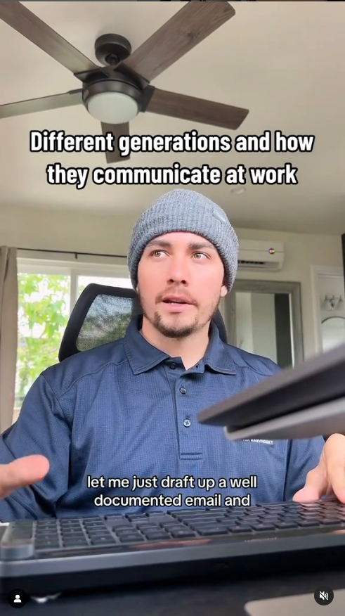
HOW DO YOU COMMUNICATE AT WORK?
Notes:
Nancy

Slide 4
GET READY FOR THE TEA
Get to know First Year Programs and the Library!
What does research say about Gen Z?
What do we know about John Jay Gen Zers?
How can we help Gen Z thrive in and outside of the classroom?
Notes:
Marta

Slide 5
Get to know First Year Programs and the Library!
1
Notes:
Nancy

Slide 6
FIRST YEAR PROGRAMS
Among the first at John Jay to welcome entering Gen Zers
Wrap-around programming from summer through first year
Summer Bridge
First Year Seminars
First Year Showcase
Academic skills development
Justice and Exploration Events
Notes:
Nancy

Slide 7
JOHN JAY LIBRARY
For many new students, the Lloyd Sealy Library is their first library experience
Library instruction in many 100-level courses (ENG 101 in particular)
Physical and online resources
In-person and virtual one-on-one research assistance
Consistently over time, first-year students are frequent library visitors
Notes:
Marta

Slide 8
What does research say about Gen Z?
2
Notes:
Marta

Slide 9
GENERATIONS BY BIRTH YEAR
 | Birth Years
Silents | 1925-1945
Boomers | 1946-1964
Gen X | 1965-1979
Millennials | 1980-1994
Gen Z | 1995-2012

Slide 10
GEN Z RESEARCH
The most diverse generation yet
On course to be the most educated generation
Most steeped in technology (including the K-12 context) so far
Pragmatic in college choice: career-oriented choices
"OK with saying they are not OK"
Socializing less face-to-face than previous generations
Katz, R., Ogilvie, S., Shaw, J., & Woodhead, L. (2022). Gen Z, explained: The art of living in a digital age. University of Chicago Press.
Twenge, J. M. (2023). Generations: The real differences between Gen Z, Millennials, Gen X, Boomers, and Silents—and what they mean for America's Future. Simon and Schuster.
Notes:
Marta

Slide 11
What do we know about incoming John Jay Gen Zers?
3
Notes:
Nancy

Slide 12
2023 ENTERING FIRST YEAR STUDENT SNAPSHOT
1901 enrolled for fall 2023 (as of 8/22/23)
99.8% are Gen Z (1995-2012)
Birth year range from 1999-2006 (17-24 years old)
Majority (80%) birth year in 2005
Would have been first year/sophomores in HS at the height of the pandemic
(Enrollment data, as of 8/22/2023)
Notes:
Nancy

Slide 13
2023 SUMMER BRIDGE SURVEY
712 respondents (as of 8/22/23)
25 questions
Based on Beginning College Survey of Student Engagement (BCSSE)
Measures prior experiences and expectations as a new student in college
Notes:
Nancy

Slide 14
“ABOUT HOW MANY HOURS DO YOU EXPECT TO SPEND PREPARING FOR CLASS EACH WEEK?” (select one)
0 hours
1-10 hours
11-20 hours
21-30 hours
30+ hours
Notes:
Nancy

Slide 15
“ABOUT HOW MANY HOURS DO YOU EXPECT TO SPEND PREPARING FOR CLASS EACH WEEK?” (select one)
Notes:
Nancy

Slide 16
“ABOUT HOW MANY HOURS DO YOU EXPECT TO SPEND WORKING FOR PAY EACH WEEK?” (select one)
0 hours
1-10 hours
11-20 hours
21-30 hours
30+ hours
Notes:
Marta

Slide 17
“ABOUT HOW MANY HOURS DO YOU EXPECT TO SPEND WORKING FOR PAY EACH WEEK?” (select one)
Notes:
Marta

Slide 18
“WHICH OF THE FOLLOWING DO YOU EXPECT TO BE THE MOST DIFFICULT?” (select one)
Learning course material
Managing your time
Paying college expenses
Getting help with schoolwork
Making new friends
Interacting with professors
Notes:
Nancy

Slide 19
“WHICH OF THE FOLLOWING DO YOU EXPECT TO BE THE MOST DIFFICULT?” (select one)
Notes:
Nancy

Slide 20
“IF YOU ENCOUNTER DIFFICULTIES, WHO ARE YOU LIKELY TO REACH OUT TO?” (all that apply)
My professors
Peer Success Coaches
Campus resources (tutoring, library, etc.)
Friends or other students
Family members
Notes:
Marta

Slide 21
“IF YOU ENCOUNTER DIFFICULTIES, WHO ARE YOU LIKELY TO REACH OUT TO?” (all that apply)
Notes:
Marta

Slide 22
“WHERE DO YOU PLAN TO DO MOST OF YOUR ASSIGNMENTS?” (select one)
During my commute
At home
At coffee shop
In John Jay Library
At campus lounge areas
Not sure yet
Notes:
Nancy

Slide 23
“WHERE DO YOU PLAN TO DO MOST OF YOUR ASSIGNMENTS?” (select one)
Notes:
Nancy

Slide 24
“HOW WOULD YOU PREFER TO DO YOUR CLASS READINGS IN ORDER TO REMEMBER?” (select multiple)
Online (ebook, pdf)
Print
Audiobook
No preference
Notes:
Marta

Slide 25
“HOW WOULD YOU PREFER TO DO YOUR CLASS READINGS IN ORDER TO REMEMBER?” (select multiple)
Notes:
Marta

Slide 26
“ARE YOU THE FIRST IN YOUR FAMILY TO ATTEND COLLEGE?” (select one)
Yes – First in the family to attend college
No – one or more attended, but did not complete
No – one of more have completed
Notes:
Nancy

Slide 27
“ARE YOU THE FIRST IN YOUR FAMILY TO ATTEND COLLEGE?” (select one)
Notes:
Nancy

Slide 28
“WHICH OF THE FOLLOWING DO YOU FEEL READY TO PERFORM?” (select multiple)
Input and organize info using Excel or Sheets
Create and share doc or presentation using Microsoft tools
Give a presentation in front of others
Creating engaging content on Canva
Ask and answer questions with other people around
Manage a project with multiple team members
Create and share doc or presentation using Google tools
Write professional email
Notes:
Marta

Slide 29
“WHICH OF THE FOLLOWING DO YOU FEEL READY TO PERFORM?” (select multiple)
Notes:
Marta

Slide 30
“HOW LONG IS YOUR COMMUTE TO CAMPUS?” (select one)
Less than 30 minutes
Between 30 minutes to an hour
1+ hours to 2 hours
2+ hours
Notes:
Nancy

Slide 31
“HOW LONG IS YOUR COMMUTE TO CAMPUS?” (select one)
Notes:
Nancy

Slide 32
How can we help John Jay Gen Zers thrive in and outside of the classroom?
4

Slide 33
WHAT ARE YOUR OBSERVATIONS OF GEN ZERS?
Hesitant to ask for help
Lower class participation compared to past years
Unsure if college is the right path
What else?
Addressing needs in and outside of the classroom
Notes:
Nancy

Slide 34
REFERENCES
Barhate, B., & Dirani, K. M. (2022). Career aspirations of generation Z: a systematic literature review. European Journal of Training and Development, 46(1/2), 139-157.
Dimock, M. (May 22, 2023). 5 things to keep in mind when you hear about Gen Z, Millennials, Boomers and other generations. Pew Research Center. https://www.pewresearch.org/short-reads/2023/05/22/5-things-to-keep-in-mind-when-you-hear-about-gen-z-millennials-boomers-and-other-generations/
Hargittai, E. and Hinnart, A. 2008. Digital inequality: differences in young adults use of the Internet. Communication Research, 35(5): 602–621.
Katz, R., Ogilvie, S., Shaw, J., & Woodhead, L. (2022). Gen Z, explained: The art of living in a digital age. University of Chicago Press.
Mintz, S. (July 14, 2023). Why does Gen Z seem especially vulnerable to stress, anxiety, trauma and depression? Inside Higher Ed. https://www.insidehighered.com/opinion/blogs/higher-ed-gamma/2023/07/14/why-does-gen-z-seem-so-vulnerable-stress-anxiety-trauma
Mohr, K. A., & Mohr, E. S. (2017). Understanding Generation Z students to promote a contemporary learning environment. Journal on empowering teaching excellence, 1(1), 9-.
Owens, E., Hwang, S. Y., Kim, D., Manolovitz, T., & Shen, L. (2023). Do you love them now? Use and non- use of academic ebooks a decade later. The Journal of Academic Librarianship, 49(3), 102703.
Seemiller, C., & Grace, M. (2018). Generation Z: A century in the making. Routledge.
Seemiller, C., & Grace, M. (2016). Generation Z goes to college. John Wiley & Sons.
The new digital equity. (October 7, 2021). The chronicle of higher education. https://www.chronicle.com/events/virtual/the-new-digital-equity
Twenge, J. M. (2023). Generations: The Real Differences Between Gen Z, Millennials, Gen X, Boomers, and Silents—and What They Mean for America's Future. Simon and Schuster.

Slide 35
THANKS!
Stay in touch!
Marta Bladek | mbladek@jjay.cuny.edu
Nancy Yang | Nyang@jjay.cuny.edu

Slide 36
THANKS FOR JOINING US!
Spring 2023
Faculty Development Day
NEXT UP:
Coffee, Cookies, & Conversation (Faculty/Staff Dining Room)
CUNY Brightspace Overview
(Zoom: check your email)
Before You Leave Us:
Post your screenshots, quotes, and insights to share on Twitter and Instagram:
@JohnJayTLC #JJC-FDD
Make notes of who you met and what you learned: keep track of what inspires you!
Complete the FDD Feedback survey: we will email you a link
Keep an eye on your faculty email for TLC announcements:)

