Slide 1
Acquiring films for class viewing
Ellen Sexton, Chief Librarian
Lloyd Sealy Library, John Jay College of Criminal Justice
August 2023

Slide 2
Does the library have the film you want?
Search for the film title with OneSearch limiting to videos;
If it’s not there, email the library at libref at jjay.cuny.edu

Slide 3
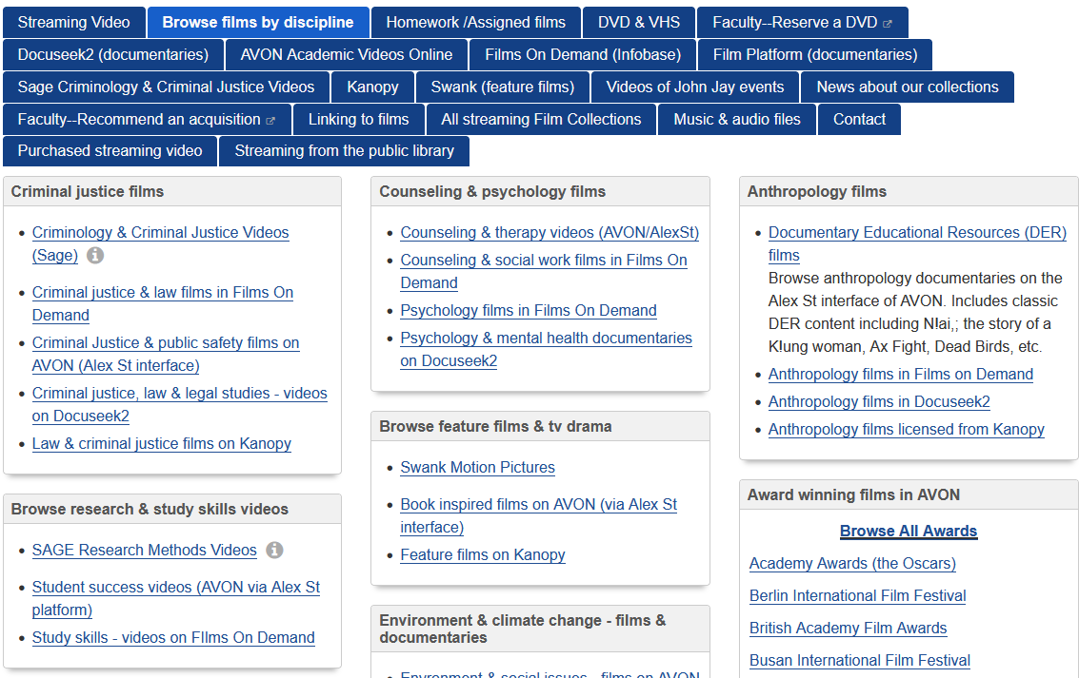
Browse our films at https://guides.lib.jjay.cuny.edu/video

Slide 4
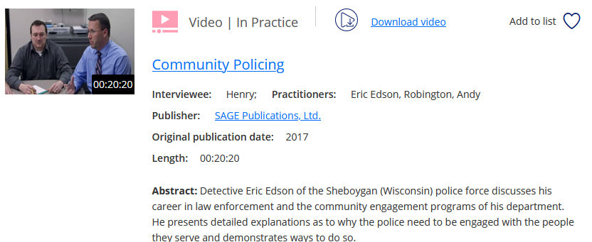
We will be considering feature films and documentaries.
But we also have packages of instructional videos, e.g
Sage Criminology videos;
Sage Research methods videos.

Slide 5
Typical film distribution pattern
First promoted at film festivals, e.g Sundance, or Human Rights Watch FF at Lincoln Center.
Picked up by a distributor and shown in theaters as long as is profitable.
Then licensed for home viewing on Amazon, or Netflix, or Apple TV or a cable network…. (home viewing, video on demand)
Released to television
Licensed by an educational distributor, e.g. Swank, Kanopy, Alex St, Proquest, Docuseek… THIS IS WHEN WE CAN GET HOLD OF IT

Slide 6
Educational distribution; which model do you prefer?
Bundled together with a great many other titles E.g. Films On Demand/Films for the Humanities, Proquest’s AVON… Professors choose from the bundle what to show in class.
Licenses can be purchased to stream individual titles from a host server, via Swank, or Kanopy. Professors choose exactly what they want, tell us, and then we pay for it.
C. Purchase a streaming license and host content at institution – WE RARELY DO THIS AND CAN’T DO IT AT ALL AT SCALE

Slide 7
Collection building challenges
Film distribution is fragmented; no single vendor can provide us with all the content we want.
Swank is easy and quick, has feature films from mainstream U.S studios, but lacks other content.
Some documentaries are never picked up by a distributor.
Independent, or non-U.S. produced films, may not have U.S. educational distributor.
Film producers from countries with robust pirating practices do not release content on DVD.
Our library does not have the ability to stream DVDs.
Our budget is limited.

Slide 8
Educational vendors & CUNY
Procurement in CUNY is slow & highly regulated.
Vendors able and willing to license a film and stream it to us must also be willing to register with CUNY as a vendor, and endure a slow painful payment process.
Happily, established educational vendors are used to selling to public educational vendors.
But new, and smaller vendors may balk.
It is currently extremely difficult to pay vendors located outside the U.S.

Slide 9
Do we purchase or license?
Licensing is generally for 12 months at a time. This is the most common option available to us.
We can renew 12 month licenses unless:
The distributor withdraws the content;
The cost is too high for us.
Purchasing is for “life of file”. It is rarely an option. And it costs more.
It is the distributor who decides whether or not to make the film available for license or purchase.

Slide 10
Intellectual property for film is complex
Multiple people have intellectual property rights; writers, actors, music composers…
Rights need to be negotiated for each distribution modality.
Documentary makers need permission to film copyrighted items (outside of fair use). If that permission is not granted, or the license expires, the documentary may be withdrawn from formal distribution channels.

Slide 11
Untold Stories: Creative Consequences of the Rights Clearance Culture for Documentary Filmmakers By Patricia Aufderheide and Peter Jaszi. 2004. Center for Media & Social Impact. https://cmsimpact.org/resource/untold_stories/
“The price of non-compliance can be non-distribution, at least until the filmmaker complies. For example, Thom Andersen’s Red Hollywood, in which he quoted much feature film material, was not distributed commercially, and was never shown in Germany because “the broadcasters were intimidated.” Aviva Kempner became embroiled in an extended conflict with the DVD distributor of The Life and Times of Hank Greenberg, because of rights that needed to be renegotiated for video and DVD distribution. PBS would not carry Robert Stone’s Satellite Sky, which referred to American cultural notions of space travel by excerpting 1950s science fiction films, until he cleared rights to films whose trailers he had used, even though the trailers were in the public domain. PBS’s demand cost his company $25,000 of his fee. Strange Fruit, a documentary about lynching, depended on music that couldn’t be cleared for home video, and is excluded from that market…”

Slide 12
Some examples

Slide 13
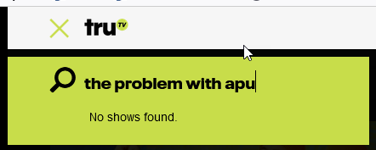
The problem with Apu This documentary was shown on Nov. 19 on truTV, and is now available only on Amazon Prime and Apple TV.
I could not get this for a professor.

Slide 14
February 2021 in theatres
May 2021, DVD available for home purchase.
Available to us (as an educational institution) to license via Swank, since at least spring 2023.
I could , and did, get this for a professor.

Slide 15
Netflix & Amazon Prime
Neither Netflix nor Amazon Prime permit streaming to institutional account holders. They sell direct to consumer.
They don't sell DVDs of their own productions.
I cannot get these for a professor.

Slide 16
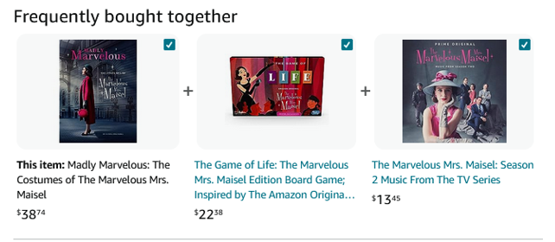
I can buy these three items from Amazon but not a DVD of the actual film series

Slide 17
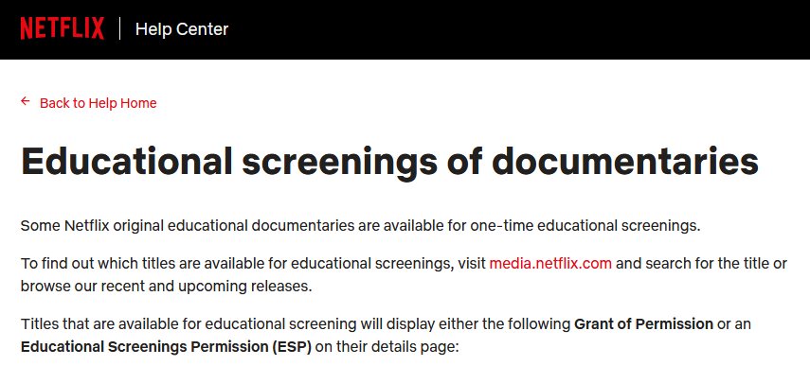
https://help.netflix.com/en/node/57695

Slide 18
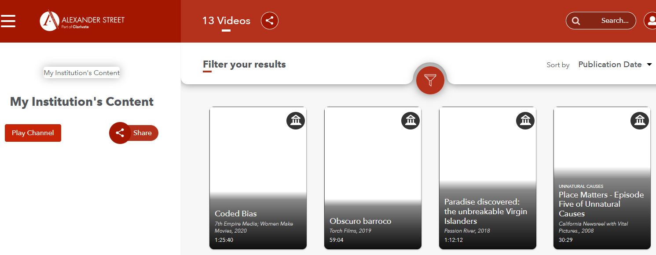
We have a handful of purchased streaming licenses where we host the content at our own institution (or rather on a rented hosting platform)

Slide 19
Questions?
Email the library
at
libref @ jjay.cuny.edu

Slide 20
THANKS FOR JOINING US!
Fall 2023
Faculty Development
Day
THANK YOU FOR PARTICIPATING!!!
Have a great start to the term!
Throughout the day:
Post your screenshots, quotes, and insights to share on Twitter and Instagram:
@JohnJayTLC #JJC-FDD
Make notes of who you met and what you learned: keep track of what inspires you!
Complete the FDD Feedback survey: we will email you a link
Keep an eye on your faculty email for TLC announcements:)

